Slide 1

Governing
together
Blockchain Summit Uruguay, Montevideo
September 05, 2019

Slide 2
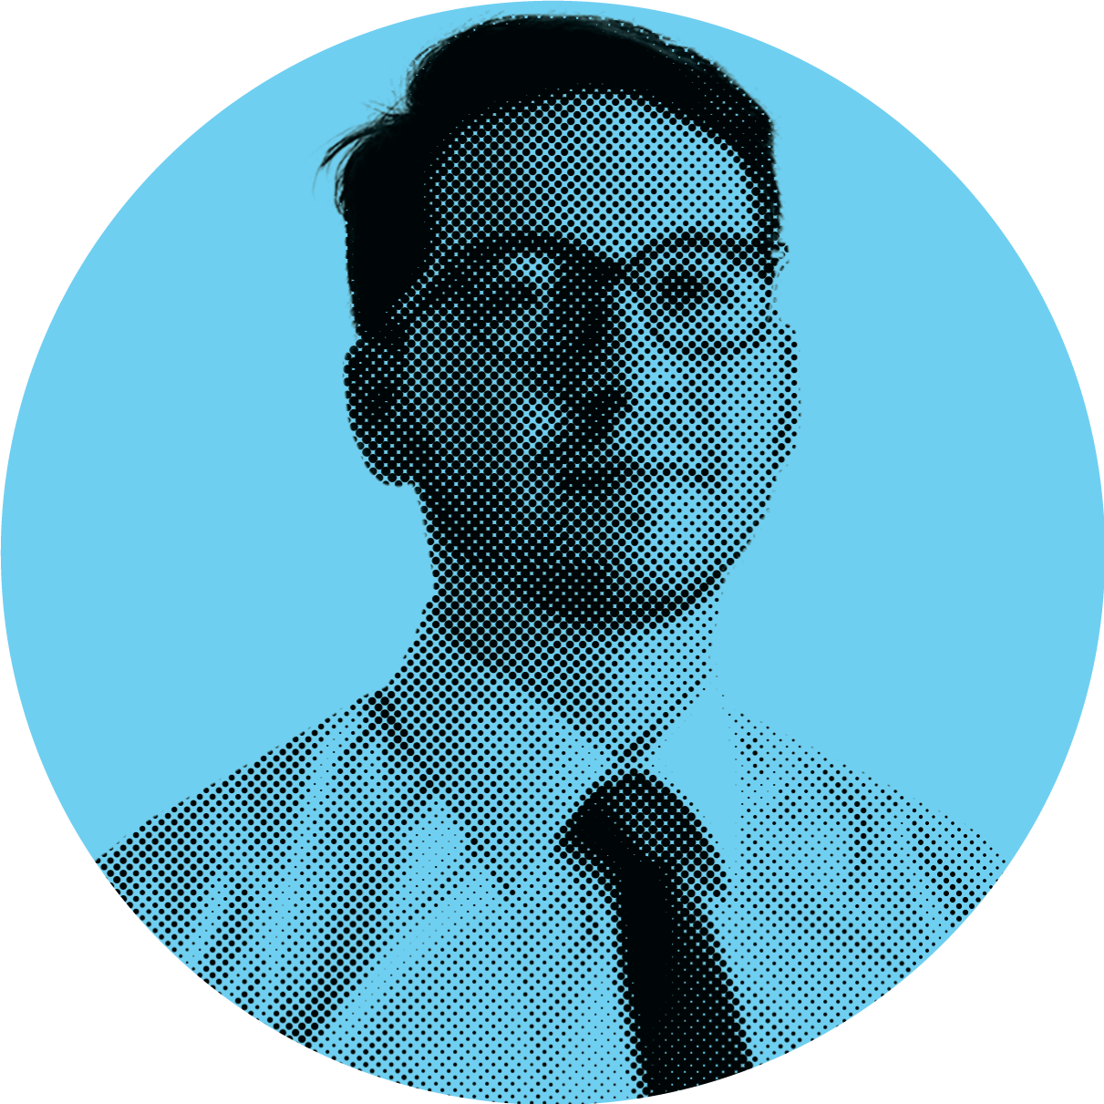


Introduction
Camilo Rodriguez
Decred colaborator

Slide 3

How do we make sure a Blockchain lasts in time?

Slide 4

How do we make sure a Blockchain lasts in time?
Technical innovation
Decentralized decision making
Self-funding
Balanced incentives
www.decred.org | Governing together | Blockchain Summit Uruguay, Montevideo

Slide 5



Three main pillars
Security
Adaptability
Self-funding
www.decred.org | Governing together | Blockchain Summit Uruguay, Montevideo

Slide 6

Security
Hybrid PoW/PoS system
Miners create blocks
Stakeholders validate blocks
PoS audits PoW
www.decred.org | Governing together | Blockchain Summit Uruguay, Montevideo

Slide 7

PoW Security
Timestamping
Blake256(14r)
More hashrate, more security
www.decred.org | Governing together | Blockchain Summit Uruguay, Montevideo

Slide 8
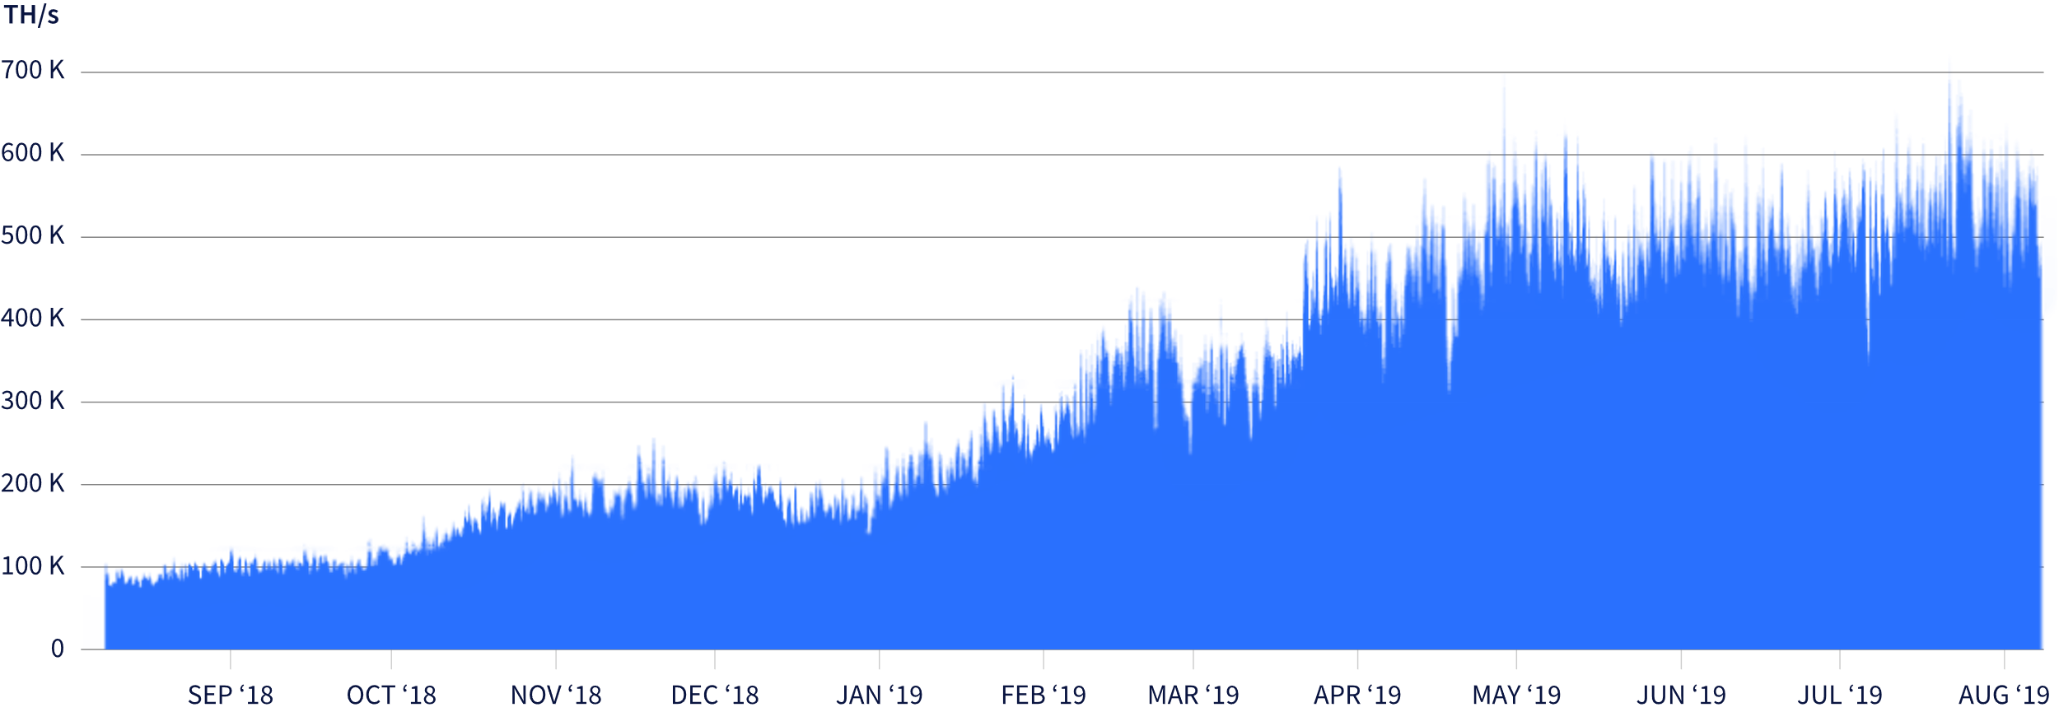
Hashrate growth
www.decred.org | Governing together | Blockchain Summit Uruguay, Montevideo

Slide 9
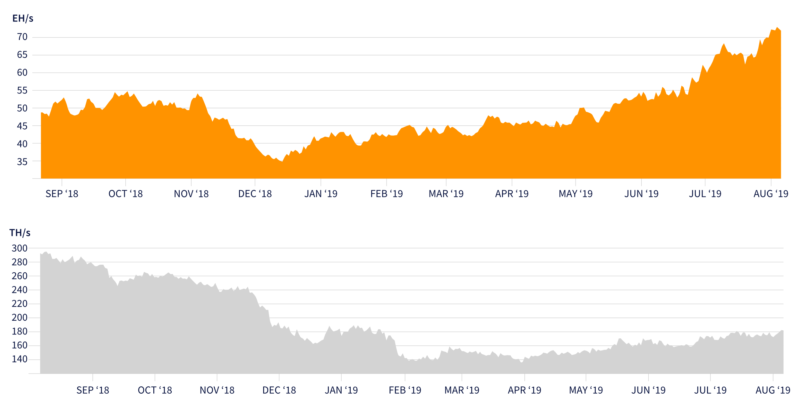
www.decred.org | Governing together | Blockchain Summit Uruguay, Montevideo

Slide 10

PoS security
Buying tickets
PoS block validation
Participation
Every new block needs 3 out of 5 tickets, of random picked tickets to be valid
PoS as 2FA for PoW
www.decred.org | Governing together | Blockchain Summit Uruguay, Montevideo

Slide 11
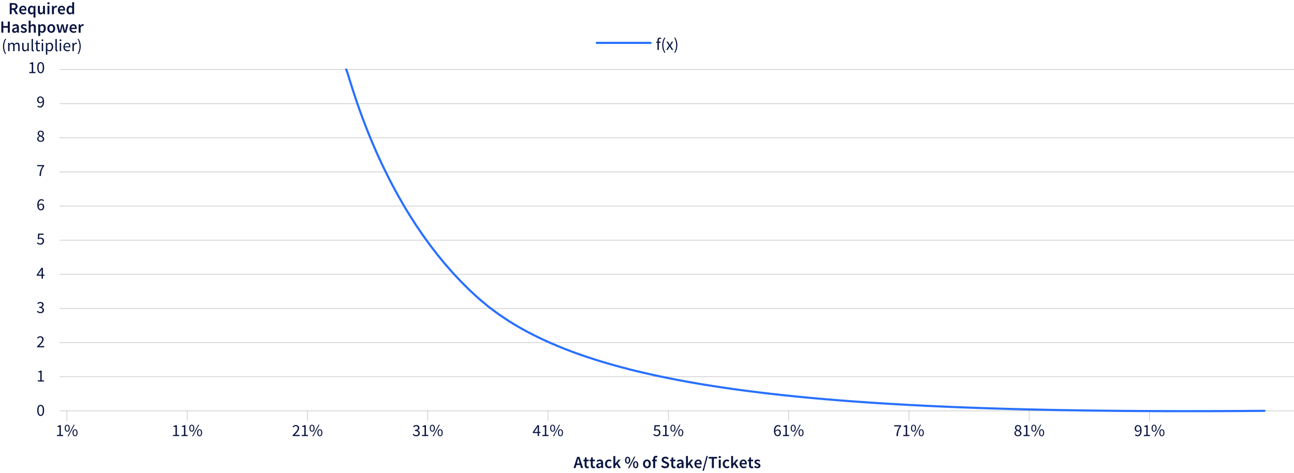
Security against majority attacks
www.decred.org | Governing together | Blockchain Summit Uruguay, Montevideo

Slide 12

Adaptabilidad & Governance
60-30-10 distribution
Voting for changes
Decentralized treasury
www.decred.org | Governing together | Blockchain Summit Uruguay, Montevideo

Slide 13
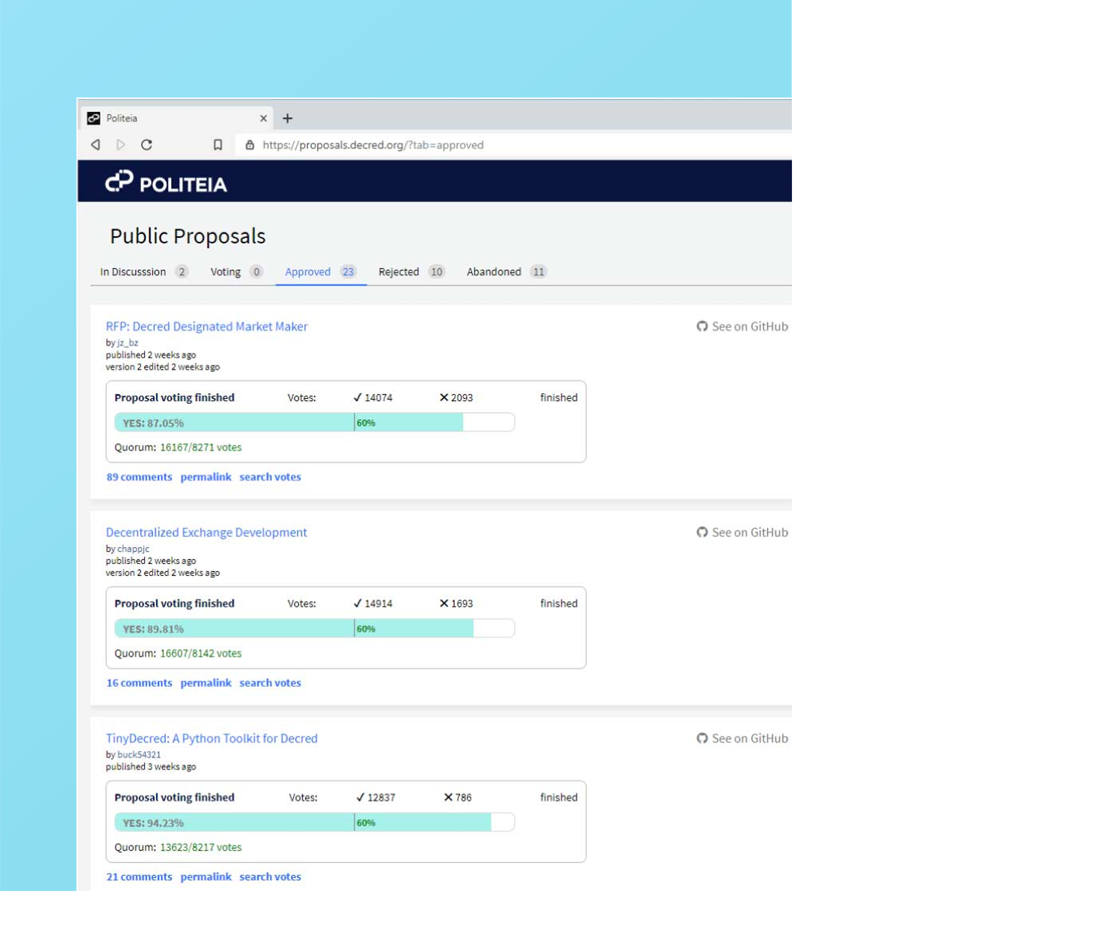
Politeia: The governance platform
To learn more about Politeia, visit: proposals.decred.org
www.decred.org | Governing together | Blockchain Summit Uruguay, Montevideo

Slide 14

Voting
The Voting Phase lasts 2016 blocks
.
.
www.decred.org | Governing together | Blockchain Summit Uruguay, Montevideo

Slide 15
Conclusions

Slide 16

Conclusions
Hypersecurity thanks to PoW/PoS
On-chain & off-chain governance
Self-funding
www.decred.org | Governing together | Blockchain Summit Uruguay, Montevideo

Slide 17


THANK YOU!
Join the conversation!
Camilo Rodriguez
Decred colaborator / CRO at Crypto Rocket
¡Follow me on Twitter! @camilolwi
www.decred.org

